Slide 1
Medi-Optix
An end-to-end platform for all medical services
Team: The Nice Guys
Keshav - IMT2021003
Sunny - IMT2021007
Tanmay - IMT2021015
Suyash - IMT2021048

Slide 2

Introduction and Proposed Idea:
Our idea offers an end-to-end medical services.
From calculating diseases from symptoms to prognosis to the specialties and then using an explore and exploit paradigm to recommend doctors.
To all the previous works done in this domain or the currently leading firms haven't employed this explore and exploit concept, which makes our platform a NOVEL IDEA.

Slide 3
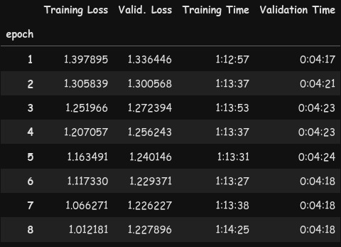
LLM Fine Tuning:
Dataset Used: ChatDoctorHealthCareMagic-100K
The dataset contains 112K rows of input output of symptom-prognosis utterances to finetune the model.
Model Used For Finetuning: distilgpt2
It is a lightweight model of GPT2, and is usually much faster, and thus preferable for fine-tuning.
Our Hugging Face Model: https://huggingface.co/23tanmay/BioDistillGPT2

Slide 4
Scoring on test DATA
Test Data Size: 20% of Total Data
Average BERT Score
Other Metrics
Metric | Value
Precision | 0.5541
Recall | 0.5389
F1 Score | 0.5449
Metric | Value
Cosine Similarity | 0.4172
Pearson Correlation Coefficient | 0.2867
KL Divergence | 22.0280
Source: https://haticeozbolat17.medium.com/text-summarization-how-to-calculate-bertscore-771a51022964​

Slide 5
Web Scrapping for Specialist Data
Used Beautiful Soup to extract data regarding the specialties and subspecialities from the given two links.
Converted the corresponding text into csv file, so it can be further utilized for computation.
Q) Why not disease data scraping and curation?
Since disease to specialty can be known beforehand.
Data Source:
Doctor Specialities
Sub-Specialities
The data contains total of 38 specialists with their descriptions covering various domains of conditions and diseases

Slide 6
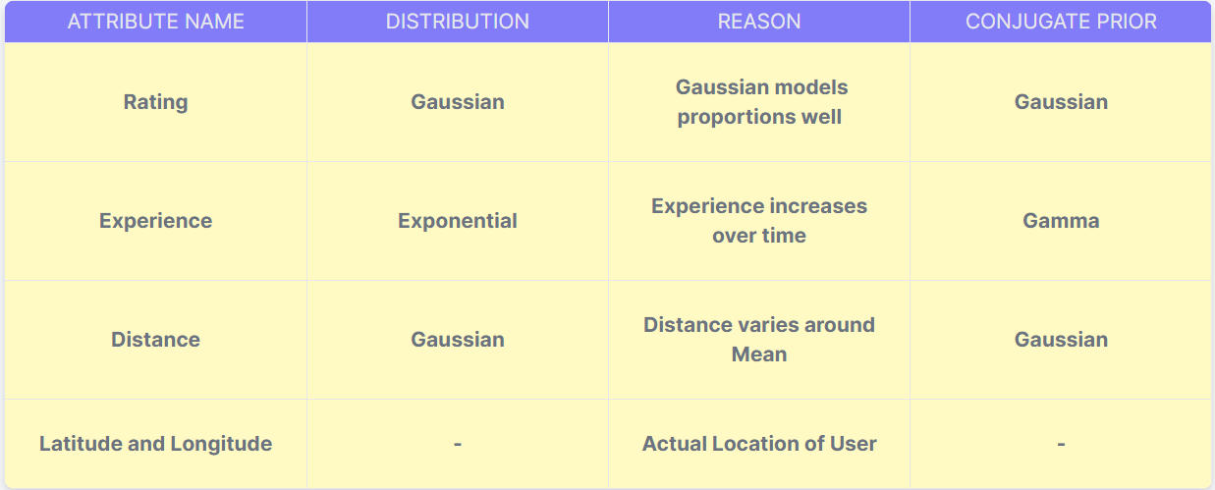
DatAset DEscription:

Slide 7
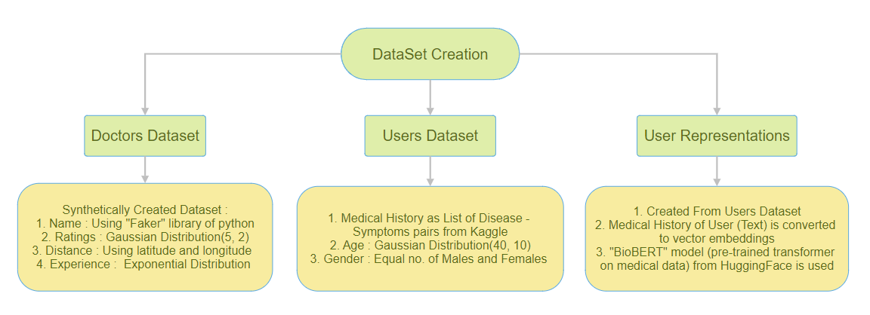
Dataset Creation:

Slide 8
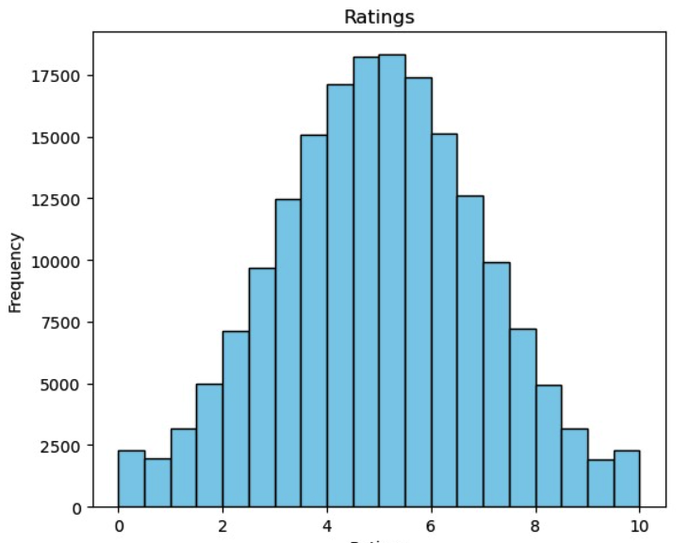
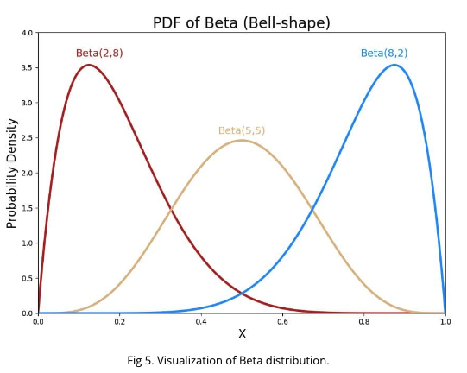
Exploratory Data Analysis:
Selection of Gamma Distribution over Beta distribution for the generation of Ratings and Experience attribute:
Reason: Beta distribution was creating a skewed pattern towards lower or the higher quartile.

Slide 9
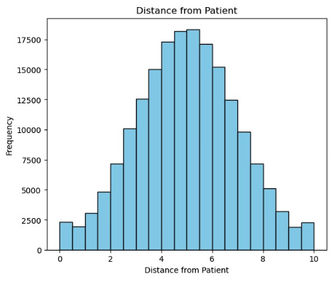
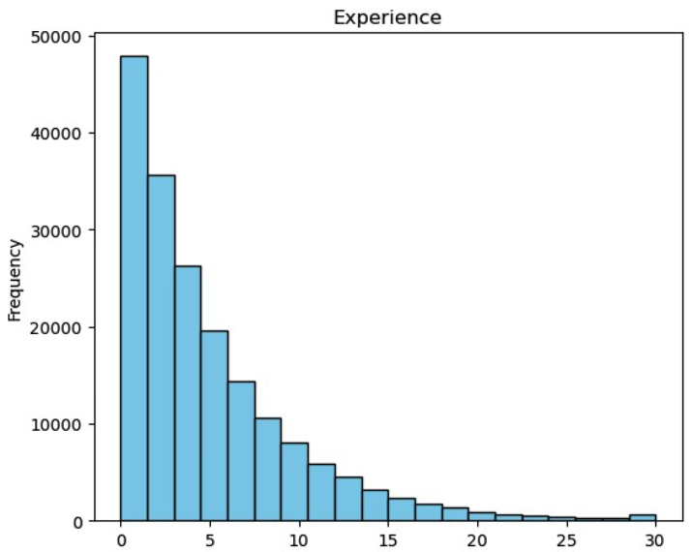
Data Distributions
Gaussian Distribution
Geometric Distribution

Slide 10
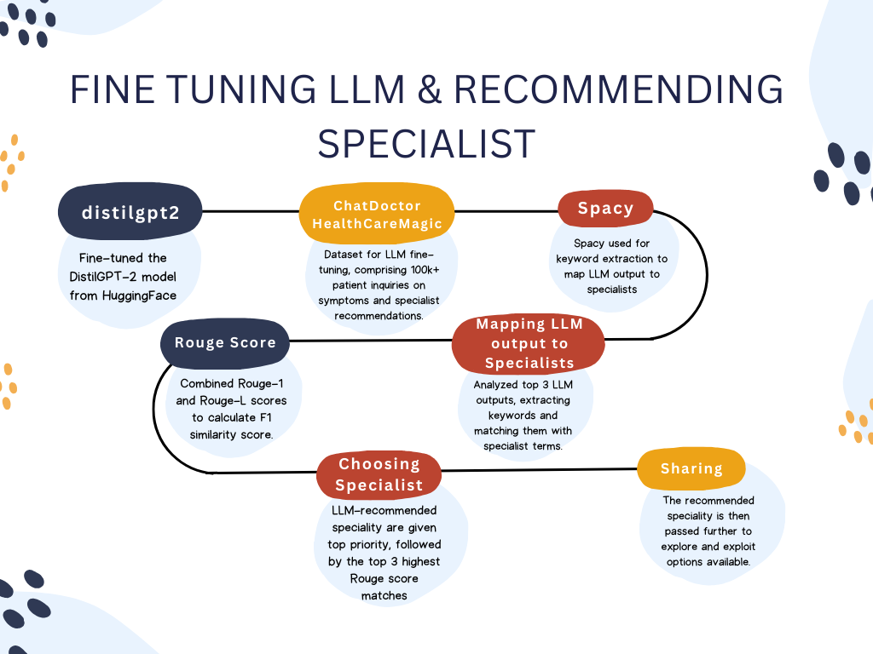

Slide 11
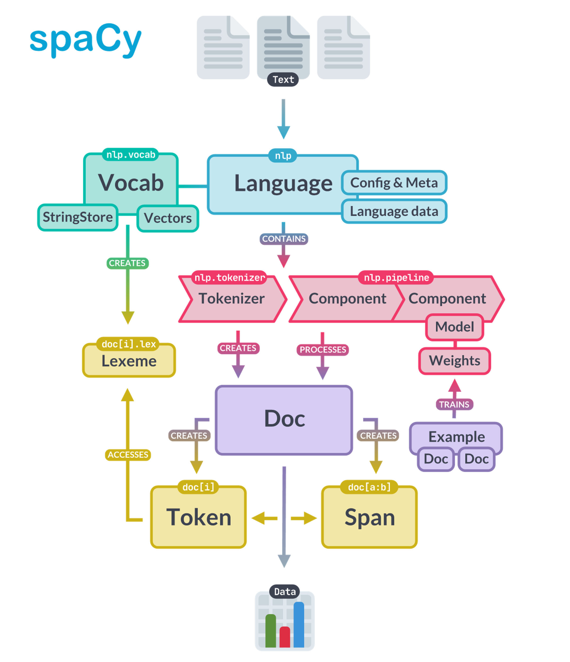
Input: I have high fever and cough from the past few days. I am having trouble breathing and extreme pain in my shoulder and neck regions. What should I do?
Output: Hello! Thank you for asking on Chat Doctor! I carefully passed through your question and would explain that your symptoms seem to be related to a viral infection. What is the reason of your symptoms? Do you have any family history of similar complaints? Have you measured your temperature lately? If you have fever, I recommend performing a complete blood count and some blood lab tests
Keywords: regions ['regions', 'high', 'tests', 'lab', 'infection', 'temperature', 'pain', 'viral', 'past', 'fever', 'breathing', 'question', 'blood', 'symptoms', 'family', 'count', 'shoulder', 'trouble', 'complaints', 'similar', 'complete', 'extreme', 'lately', 'carefully', 'history', 'days', 'few', 'cough', 'reason', 'neck']

Slide 12
Rouge-1 and ROUGE-L Score
ROUGE-1 Score: It is useful for assessing basic factual overlap between the summaries. Similar to 1-gram.
ROUGE-L Score: This metric is based on the Longest Common Subsequence (LCS) between the two texts.
NOTE: Specialists appearing in prognosis results are considered as top recommendation with score of 1.
Why not vectorize and calculate similarity between specialists and prognosis?
Vectorization results to bias.
Poor results on similarity-based coefficients.
Capturing specialties from prognosis

Slide 13
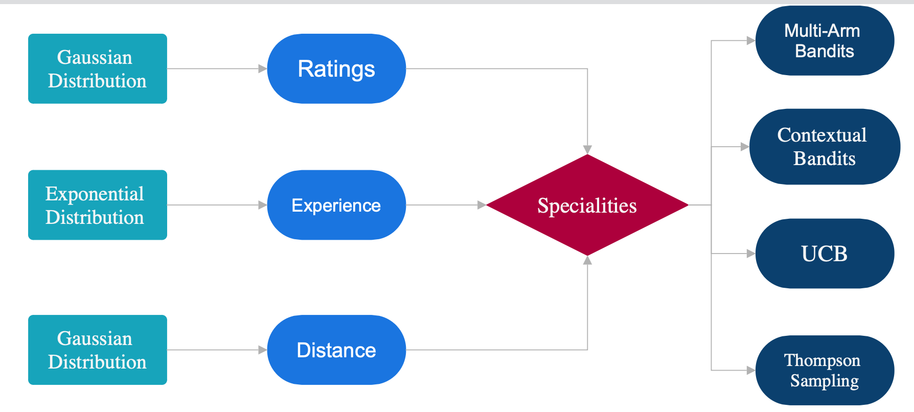
Workflow-PArt:2

Slide 14
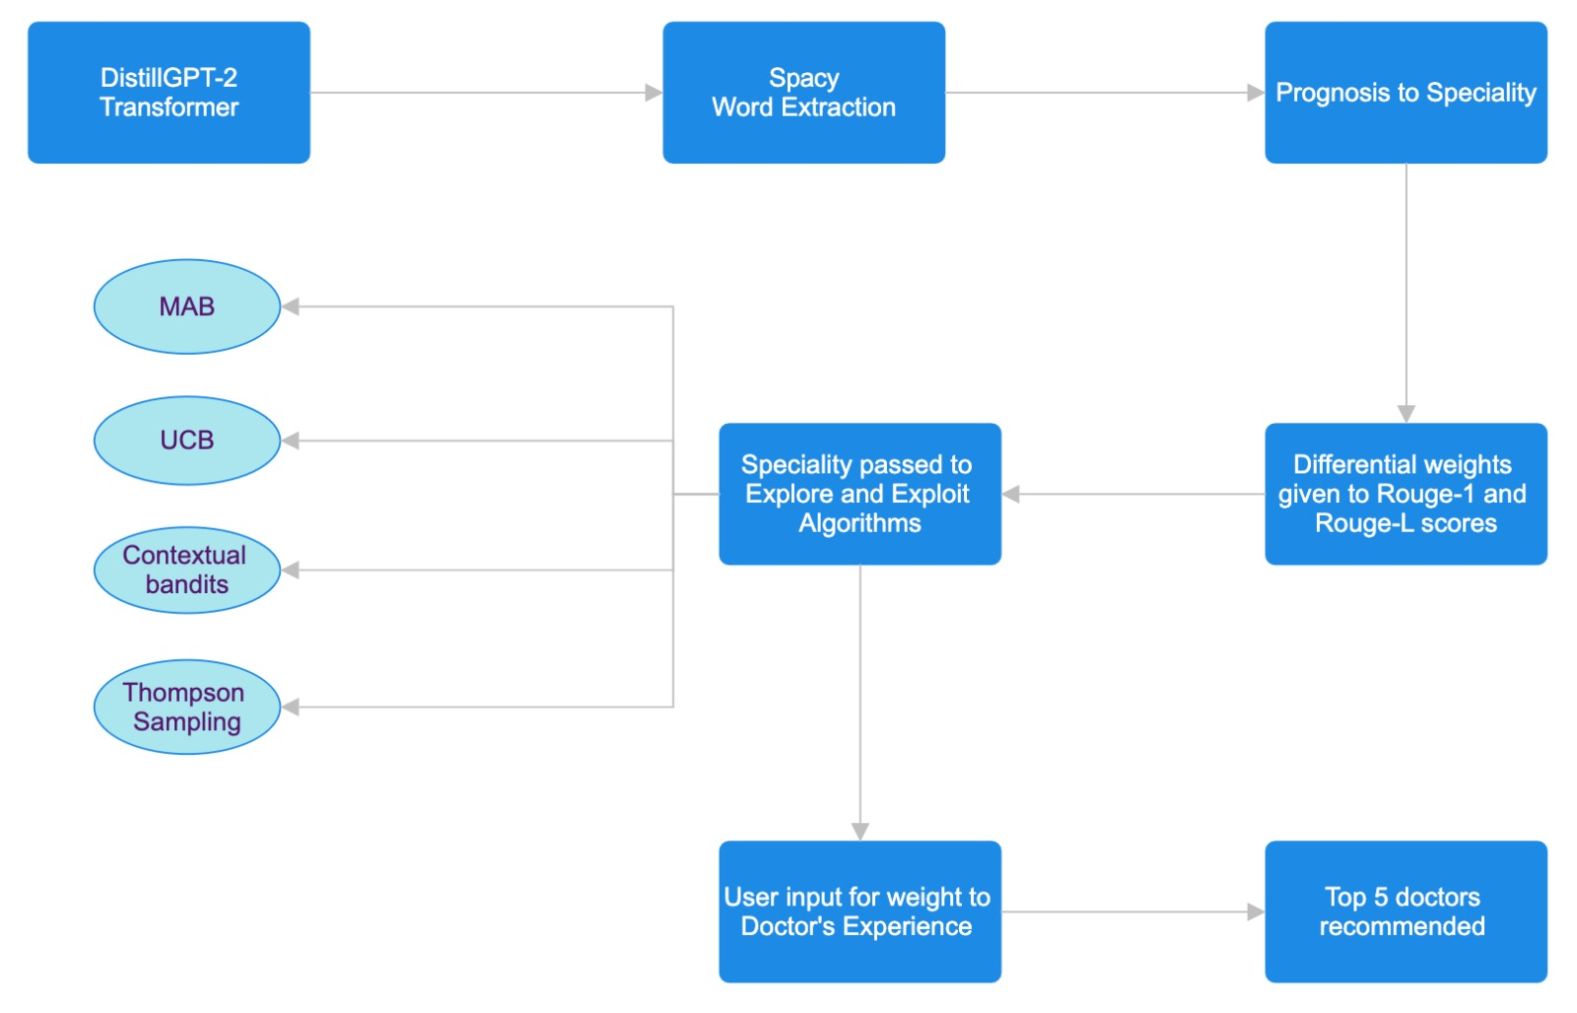

Slide 15
Sample Prompts:
Input | Specialties | Score
I am having sudden blood pressure fluctuations, feeling continuous numbness, and fatigue from past 6 days. I have skin rashes, feeling itchy, redness in my thigh and back regions as well. | Neurology Otolaryngology Internal Medicine | 0.09687 0.0916 0.0854
I am having a lump in my neck region with difficulty in speaking due to pain that comes with it's movement. I am also having trouble eating and drinking due to this issue. | Otolaryngology Radiology | 0.0924 0.087

Slide 16
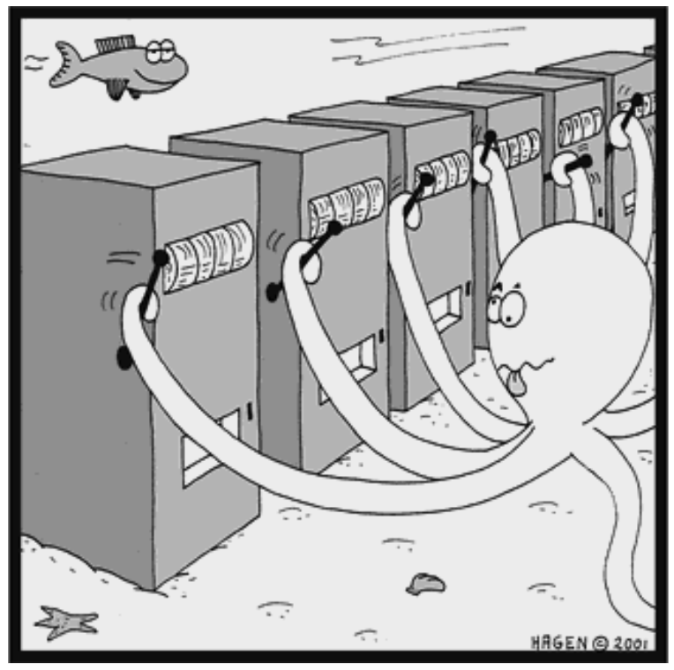
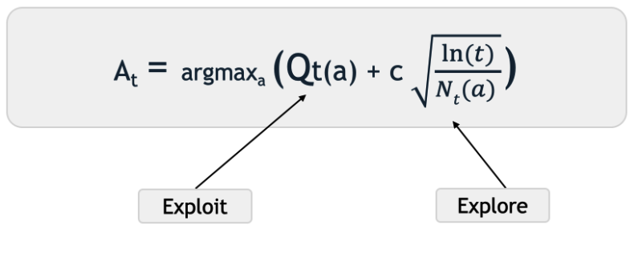
Algorithm Analysis:
Multi-Armed Bandits
Upper Confidence Bound

Slide 17
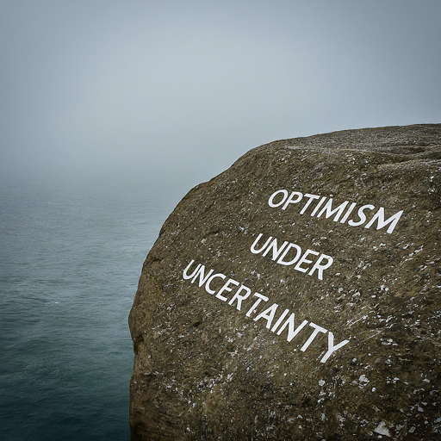
Multi-Armed Bandits vs Upper Confidence Bound
In case of UCB, the algorithm converges quickly towards the better choice which is greater composite score computed as weighted average of the ratings and the experience.
The weights is decided according to the user input, which is taken on a scale of 0 to 9.
UCB is particularly strong in environments where a clear best choice exists.
UCB Requires more computation for each decision because it calculates a confidence interval for every action each time an action needs to be chosen.

Slide 18

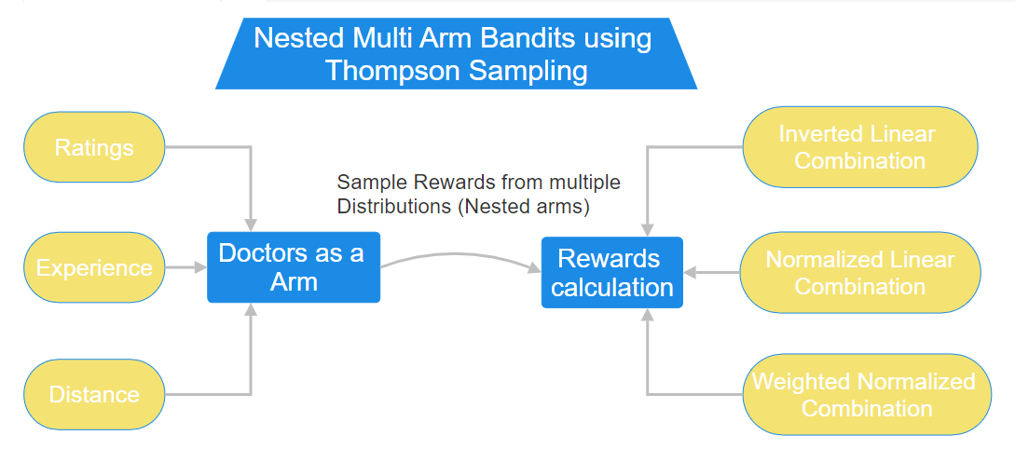
Algorithm Analysis:

Slide 19
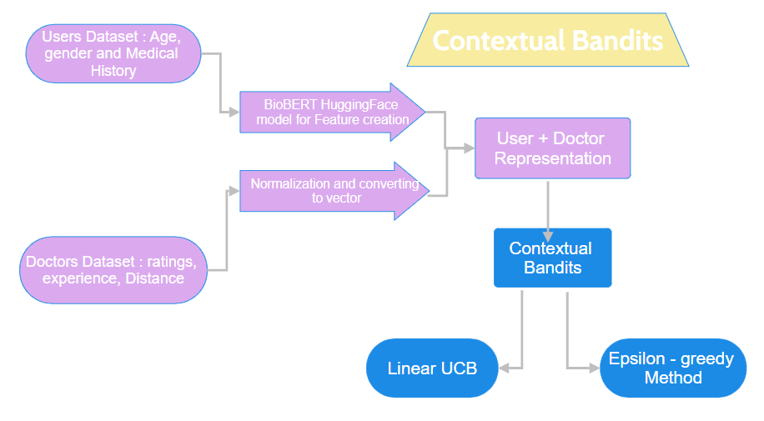
Algorithm Analysis:

Slide 20
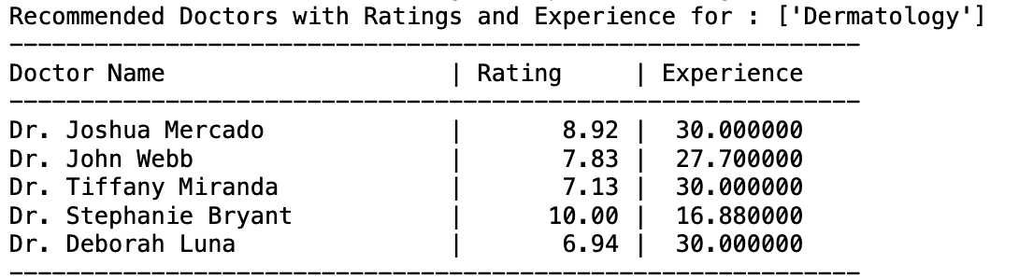
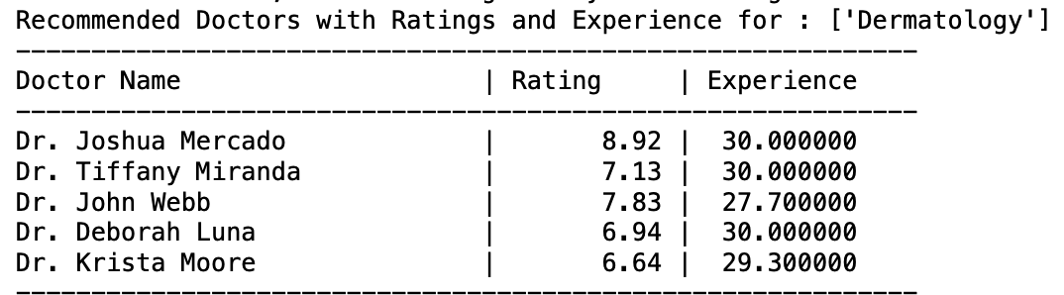
UCB
MAB
Its more inclined towards optimistic results.
More focused on exploring.

Slide 21
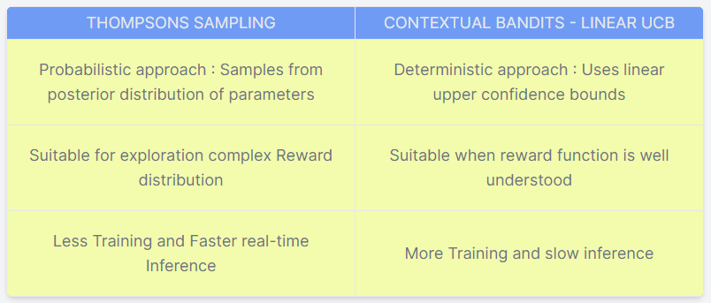
Thompson Sampling vs Contextual Bandits:

Slide 22
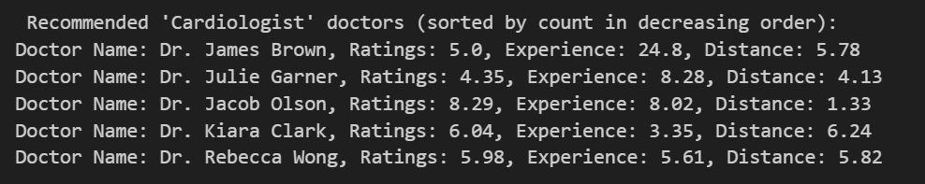
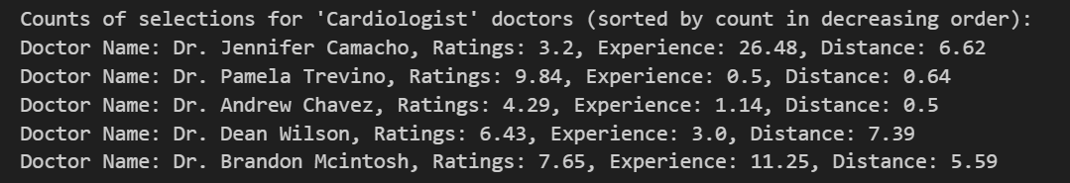
Nested MAB using Thompson - Results:
Result Analysis :
Diversity in results
Some recommendations have high ratings while some have good experience or less distance. (Choice given to users)
Exploration is more than exploitation

Slide 23




Evaluation Metrics (LLM)
Keyword Extraction
ROUGE Score
LLM Recommendations
Thresholding
Extracted Nouns, Adjectives and Adverbs from the LLM output, for score calculation with the Specialists' description.
Calculated ROUGE-1 and ROUGE-L Scores of similarity.
Levied weighted combination of the 2 scores
Searching for the specialist in the LLM output. If found one, it is assigned ROUGE Score of 1.
Chose a threshold such that adjacent specialists having score difference above threshold aren't recommended

Slide 24

Evaluation Metrics(Part-2)
Regret​
Coverage
Hit Ratio
Reciprocal Hit rate
Difference between the expected reward of the optimal action and the expected reward of the chosen action over time.
Proportion of Items in the recommendation space that is covered
Recommendations above a optimal threshold is considered as hit
Reciprocal of Ranks of top-k recommendations in best rewards

Slide 25
Working of the system
Our Proposed solution offers an end-to-end Medical Services
From calculating the Diseases as the user gives His/her symptoms, then symptoms are being mapped to the Specialty as curated in the dataset.
The Mapped specialty is then moved to the other part of our system where corresponding to Each Specialty, we have a list of doctors along with their ratings and experience.
To the list of doctors, we are implementing the algorithms --> MAB, Contextual Bandits, UCB and Thompson sampling

Slide 26
Thank you
~Team : Nice Guys

